Slide 1
Growth and Development
Lecture 4

Slide 2
Readings
Michael Todaro and Stephen Smith ( 2014) Economic Development- Pearson Publishing (Chapter 3, various parts)

Slide 3
Growth theory and growth models
Motivated by the question what drives the process of economic growth and formulate a mathematical growth path based on social and economic parameters
Modern growth theory starts with the Harrod- Domar model based on a broadly Keynesian formulation ( mid 1940s). Taken up by newly developing countries as a policy guiding formulation in the 1950s
Followed by neoclassical growth model credited to Solow and Swan (separate papers both published in 1956)
The modified neoclassical models called endogenous growth models starting from the late 1980s

Slide 4
Basic structure of the Harrod-Domar model
- Savings function S= sY (1) 0 < s < 1
Total savings is a proportion of total income
- Investment I = ΔK (2)
Investment is change in capital stock (K)
- K/Y = ΔK/ΔY = c (3)
Assuming production to be based on capital only (simplification) with constant returns to scale
- S = I (4)
- sY = c ΔY (5)
- ΔY/Y = s/c (6)
- g = s/c (7) g being the growth rate of income

Slide 5
Implications of the growth equation
Growth rate is a function of s, the savings propensity and c = K/Y or the capital output ratio.
1/c can be thought of as the efficiency of capital in producing output.
A plausible g with s = 15 % and c = 4 is only 3.75 %
Growth rate can be pushed up from both ends- higher savings rate or higher efficiency of capital use
However, these are unlikely to be independent channels
The key implication is the necessity of augmenting savings rate continuously to ensure higher growth rates
Any deficit in domestic savings ( and therefore investment) to achieve a ‘desired’ rate of growth can be met in principle by foreign sources

Slide 6
Solow-Swan Model or the neoclassical growth model
Assumptions:
Production function with two substitutable factors Capital ( K) and labour ( L) unlike the Harrod-Domar model
Constant Returns to Scale ( CRS) production function
Y = F ( L, K) F_{L} and F_{K} > 0 and F_{LL} and F_{KK} < 0
Diminishing marginal returns to capital and labour
There is a constant rate of growth of labour force n (ie dL/dt/L = n)
Constant depreciation rate 𝛅
Savings is a fraction of total income and all savings is invested
S = sY and I = ΔK = S

Slide 7
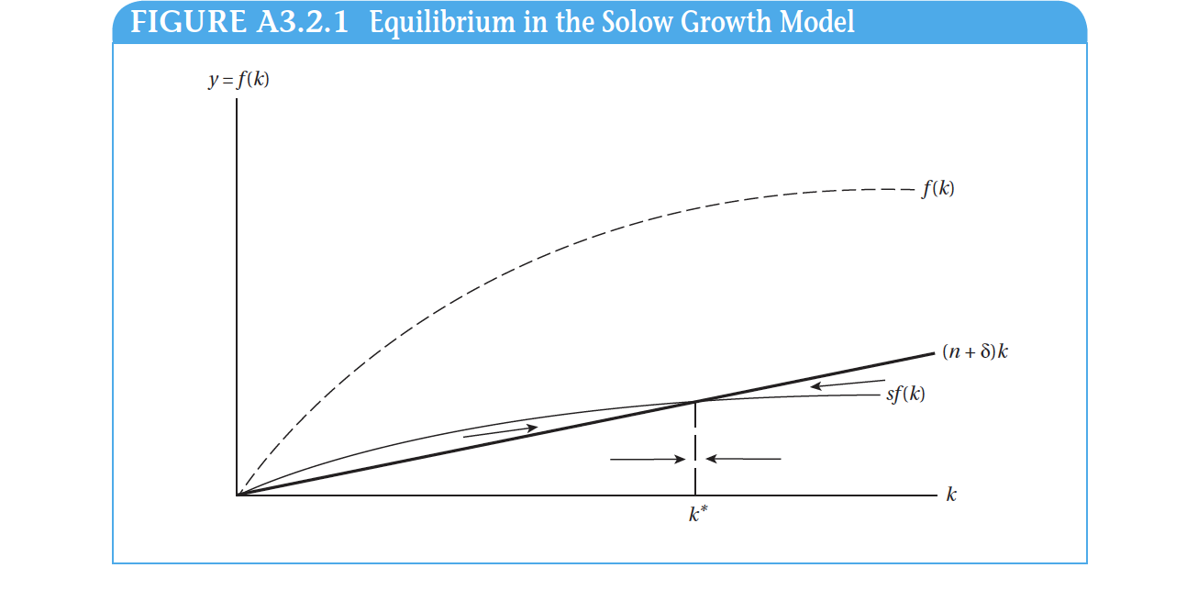

Slide 8
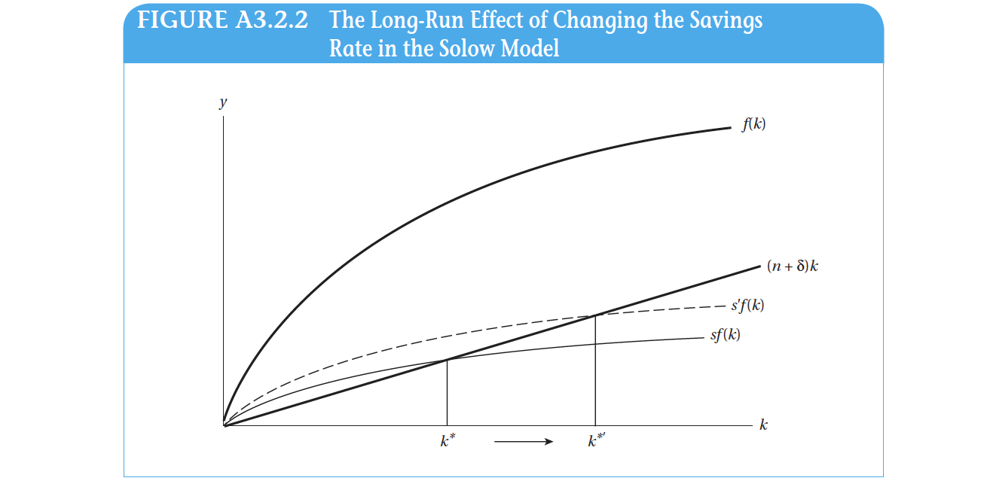

Slide 9
Some concerns from the Solow model
What happens when population growth rate increases?
What is the idea of convergence coming out of the Solow model?

Slide 10
Solow residual and the idea of endogenous growth
The Solow(neoclassical) model has limited capacity to explain the sources of growth in reality
Only 50 percent of historical growth is accounted for adjustments in K and L ( or k ). The rest is clubbed together as the Solow residual i.e. not assigned to any explicit source of growth
The understanding was that the Solow residual is a result of technological progress
But this progress is not endogenous to the Solow model
Also, the Solow model has no room to understand long-term growth ( which is 0 )
Lastly, the thorny issue of convergence that the Solow model predicts

